Slide 1
2024 Awards
Project Spotlight
Five Winners each Quarter
Emphasis being placed on
Community Impact
Uniqueness
Volunteer
involvement
Simple
Application

Slide 2
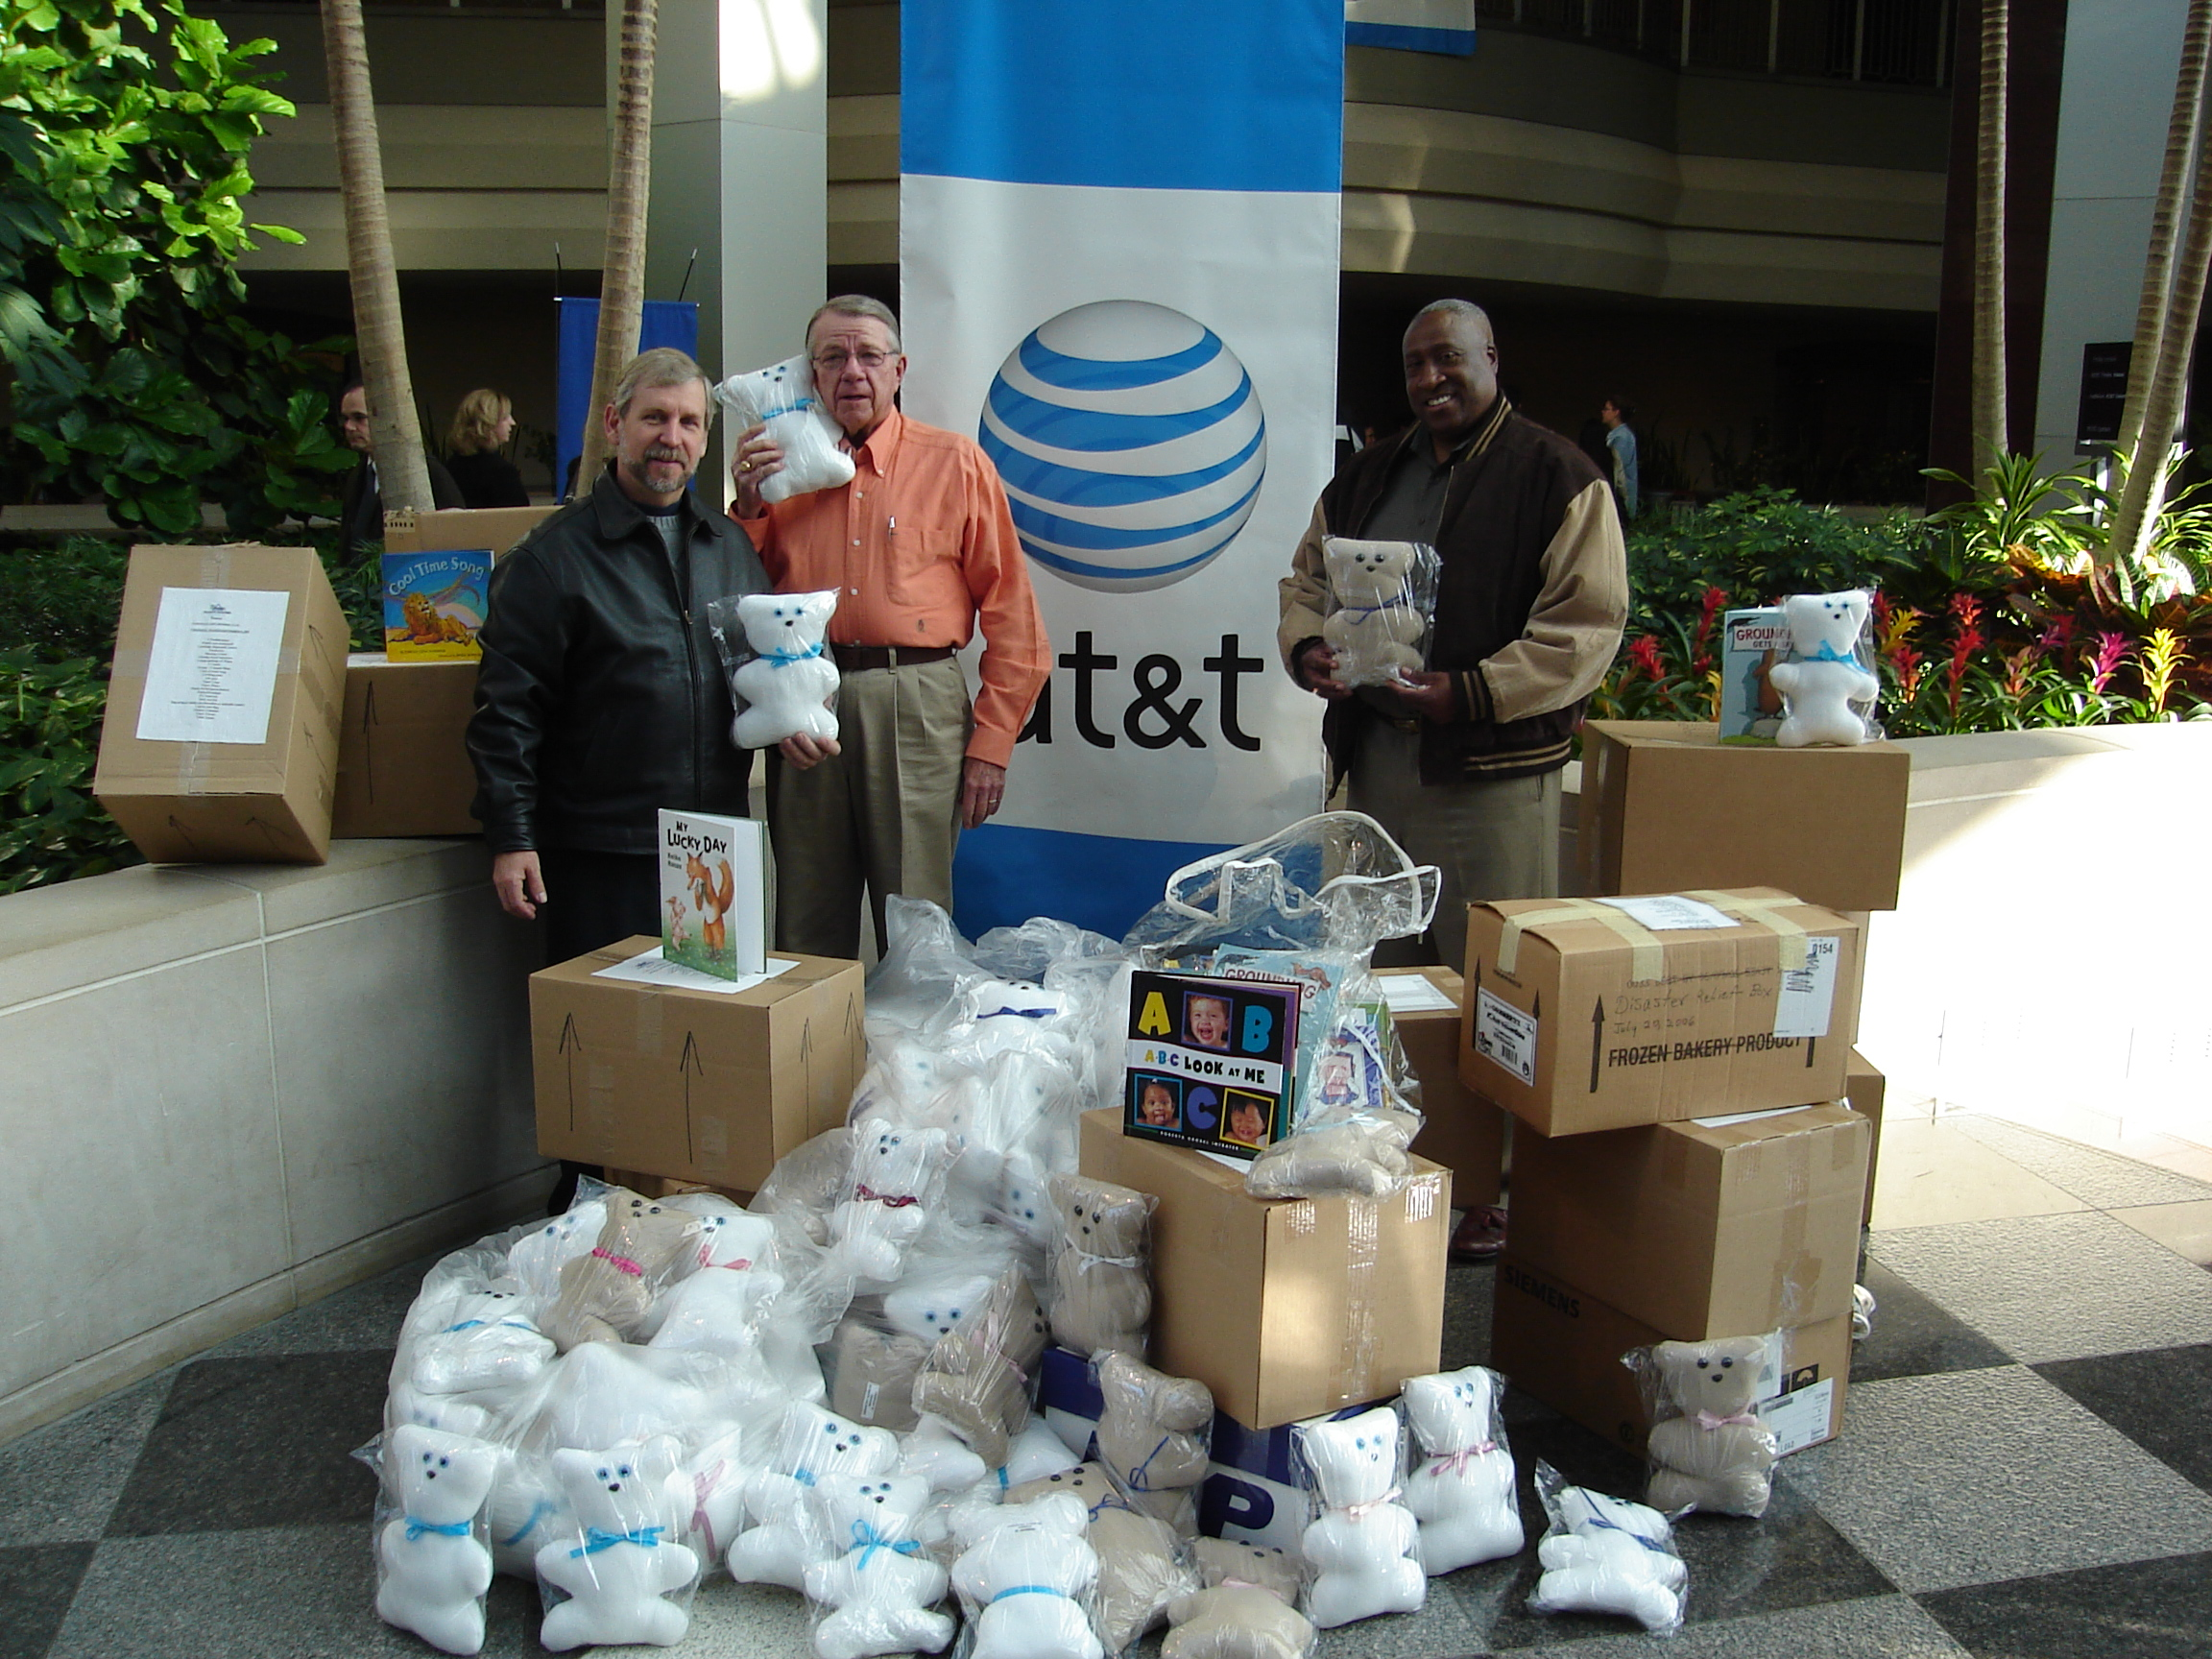
Project Spotlight
Pioneers from the Tennessee Chapter donated 300 Hug-a-Bears as well as several reading books to the local Boys and Girls Club. The bears were hand-crafted over a six month period by over 20 members of the local Life Member base. The Boys and Girls Club will use these items to support the local youth in the greater Nashville area.

